Slide 1

Corporate Presentation
August 2021
Confidential
Notes:
1

Slide 2
Introducing Magnum Group International
“... if we're going to make progress with sustainability we'll have to accept the fact that many people are like Faust — they will sell their souls (or at least their planet) to the devil in order to maintain their current standard of living. Until we give them a better choice, and prove that sustainability doesn't require sacrifice, we'll be fighting an uphill battle...” Sustainability's Faustian Dilemma April 5, 2011 - Ron Ashkenas.

Slide 3
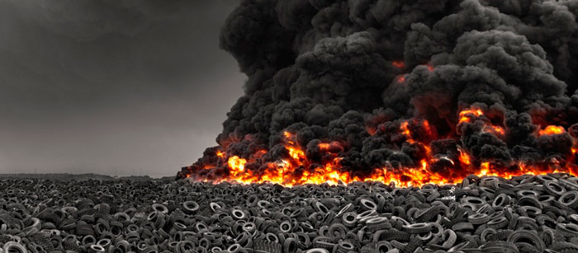
Waste - the Opportunity & the Solution
Society is waking to the reality that we cannot continue to treat waste by: burying it, pushing it into huge piles, or incinerating it.
With Global Climate Change threatening us government and industry are being forced to consider the Greenhouse Gasses being released by all this carbon based waste.
Into this environment Magnum Group International brings it’s truly disruptive Advanced Thermolysis System (ATS) Technology.

Slide 4
Introducing Thermolysis
Thermolysis takes place when a carbon based substance is subjected to a very high temperature in the absence of oxygen. Without the oxygen combustion cannot take place and instead the substance is broken down into its constituent elements: gas, oil and carbon.

Slide 5
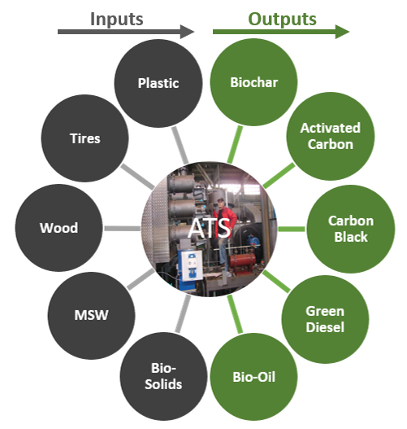
Waste to Carbon by Thermolysis

Slide 6
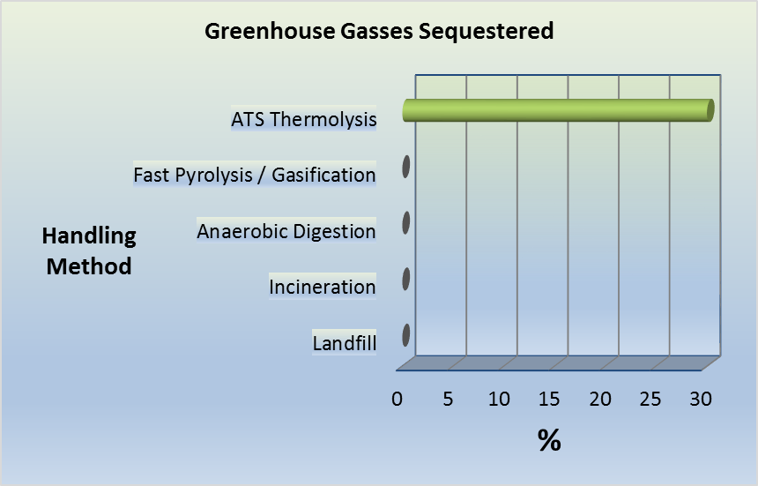
Fighting Climate Change

Slide 7
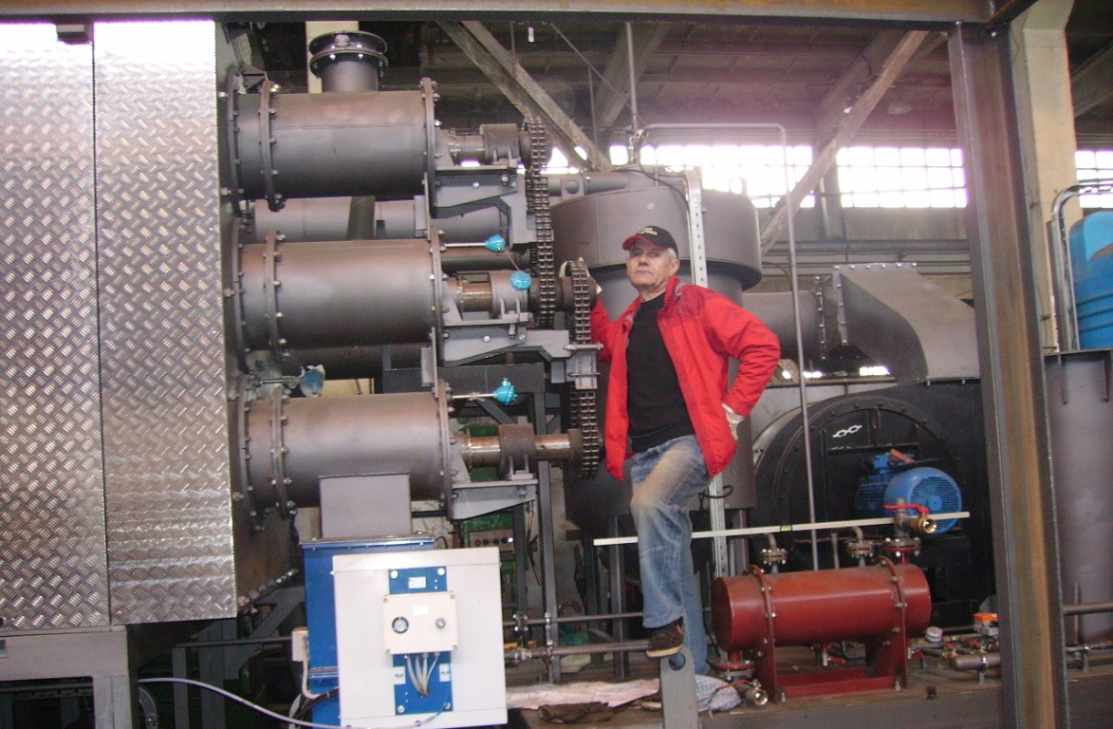
Advanced Thermolysis System (ATS) Proven Technology
2006 – 1st Generation ATS technology is a 500 kg/hour model. It is thoroughly tested under real-world conditions. After demonstrating areas where improvements could be made the model is decommissioned and replaced with the 2nd generation plant.
2008 – 2nd Generation 2000 kg/hour plant is tested under actual conditions for an extended period, then decommissioned to make way for the next generation.
2014 – 3rd Generation ATS500 is manufactured & rigorously tested. It demonstrates excellent operating specifications but gives way to the 4th generation, with its improvements.
2016/Present – 4th Generation ATS500 is commissioned for commercial operation in Hope, British Columbia, Canada

Slide 8
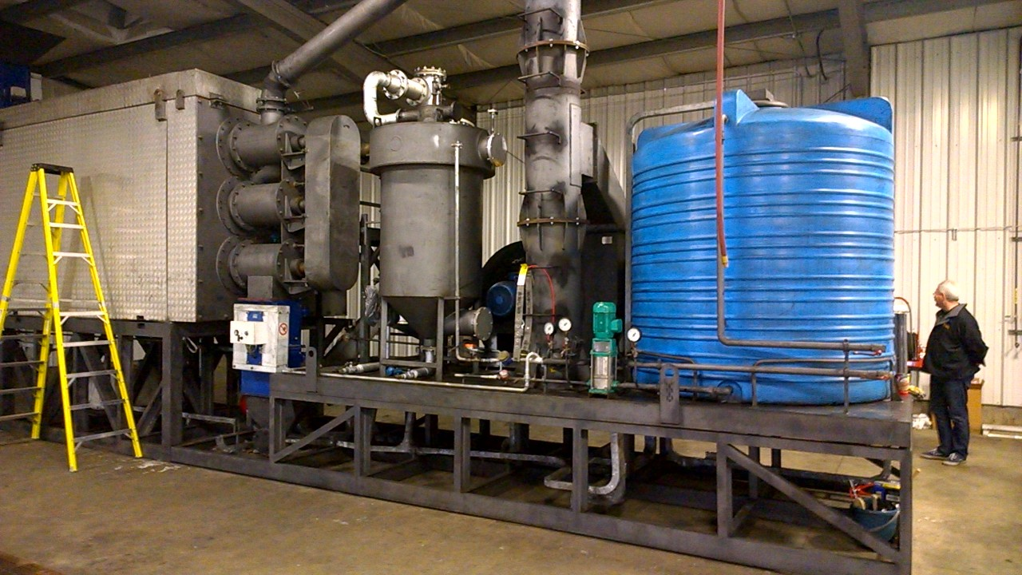
ATS500 in Vegreville Alberta, Canada

Slide 9
Benefiting Communities
Community
Solving Waste Problems
Profits for Industry
Expanding Tax Base
Tourism
Social License
R&D
Jobs
Direct
Spin-Off
~10 full-time workers for ATS500 system
~20 full-time workers for ATS2000 system
Employment during assembly & site prep:
Electricians
Welders
Pipe-fitters
Carpenters
Machinery operators
Technicians etc.

Slide 10
Canadian Market & Carbon Savings Potential
Waste Stream | Plants Required to Process Waste Stream | Tonnes of CO2 Potentially Saved *
Livestock Manure | 644 | 6,694,380
Municipal Sewage Sludge | 143 | 1,486,485
Used Rubber Tires | 23 | 358,628
Recycled Plastic | 110 | 1,588,125
Municipal Solid Waste, food waste, etc. | 784 | 4,980,360
Pulp Mills | 114 | 1,580,040
Waste Wood Biomass | 1,734 | 24,033,240
Total | 3,552 | 40,721,258
* Source: http://www.engineeringtoolbox.com/co2-emission-fuels-d_1085.html | http://www.ieabioenergy.com

Slide 11
Business Model
Magnum has analysed several business models to come up with the optimal model for the company, its shareholders, our strategic partners and the communities we will serve.
The model selected is the Joint Venture model. Under this model Magnum does not sell plants, it sells joint ownership in projects. There are a number of reasons why this is advantageous, they include:
Limiting competition in the end-products markets
  All product sales go through Magnum so selling prices are tightly controlled
Ensuring the efficient operation of the plants, thus protecting the Brand
Ensuring safe operation of plants
Maintaining strict environmental standards
Optimizing return on investment for Magnum’s JV partners
Ensuring Magnum’s technical team and expertise are always available to the projects
  This protects the interests of our valued JV and other strategic partners
Previously, manufacturing of the core elements of the plants was in Europe, at a facility that our technicians familiar familiar with. But eventually, this is being phased out and the manufacturing of the ATS system will be handled by our manufacturing associate, MGI Thermolysis Systems Inc. in British Columbia, Canada.
With each project there are equipment requirements above and beyond the core plant, these elements can and should be manufactured in the country hosting the project. In such instances, Magnum will benefit from recommendations and referrals from our Joint Venture partners.
Environment
Limiting competition
Safety
Efficiency
High ROI

Slide 12
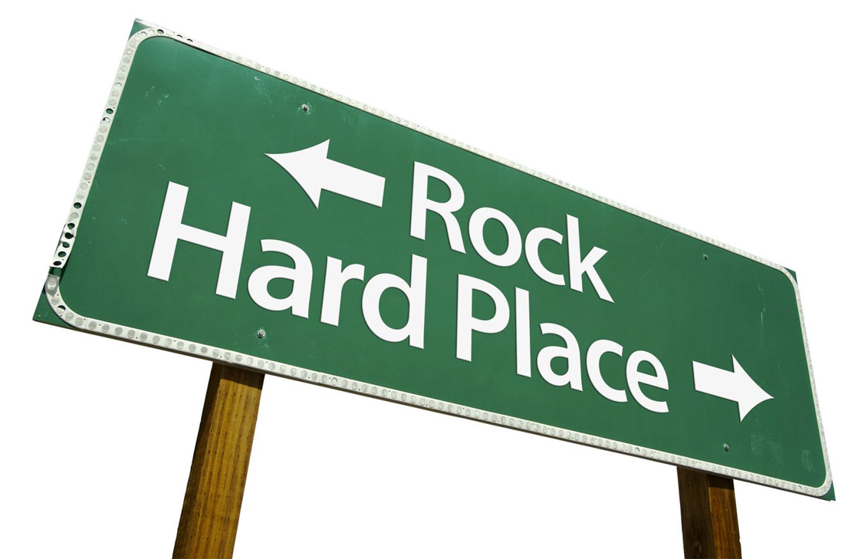
When it Comes to Garbage, Municipalities find themselves between a ...

Slide 13
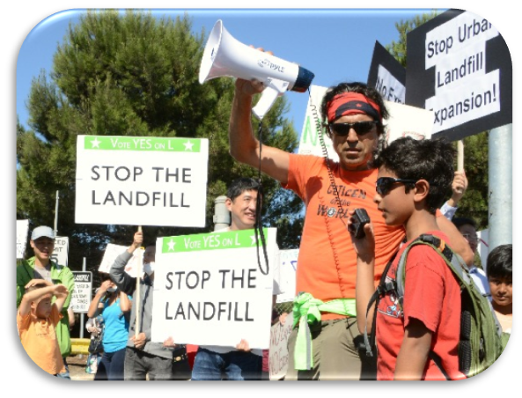
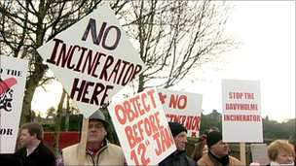


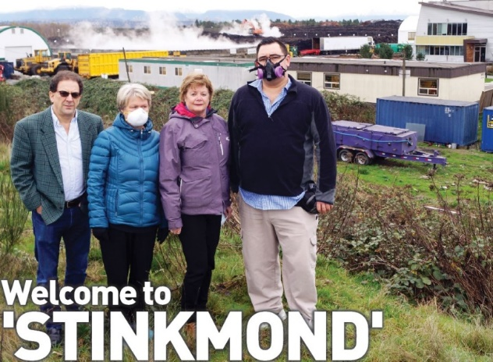
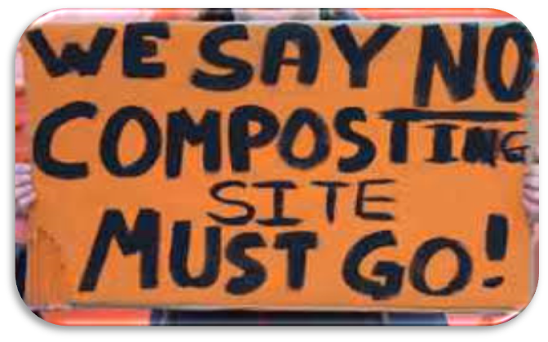
The
Rock
Incineration
Cities
The
Hard Place
Composting

Slide 14
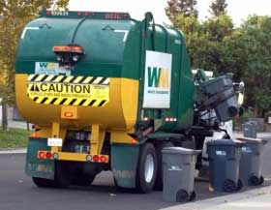
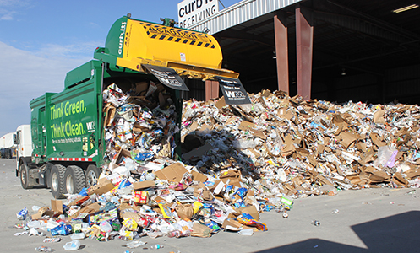
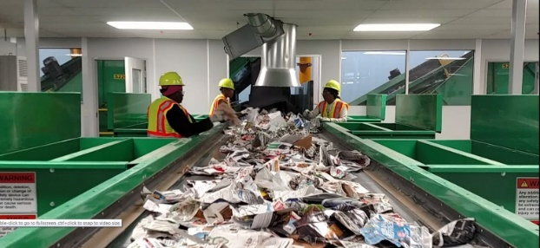
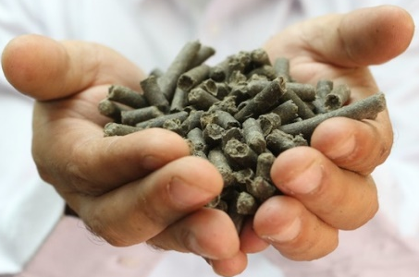
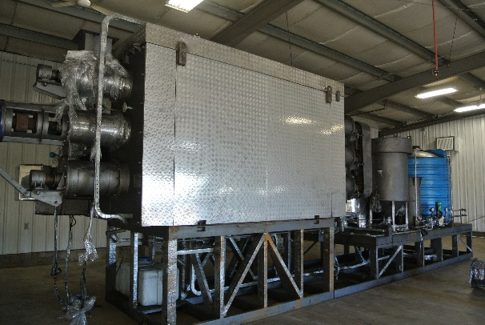
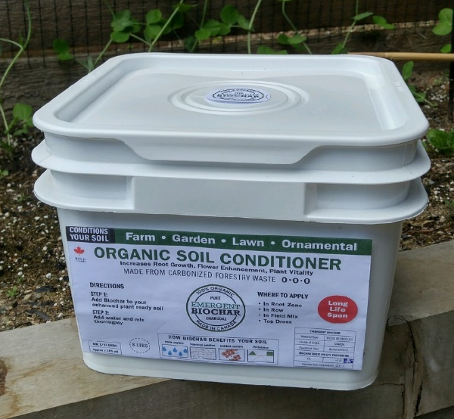
Environmentally and Economically Sustainable
All other waste is taken to a central processing center
Home-owners remove only metal & glass
Pellets are fed into ATS Plant
Non-Carbon material is removed & Refuse Derived Fuel (RDF) pellets are created
Valuable Biochar and or activated carbon is created

Slide 15
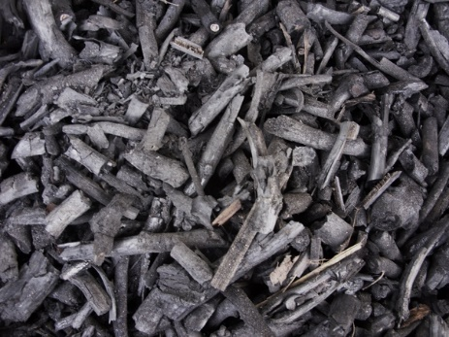
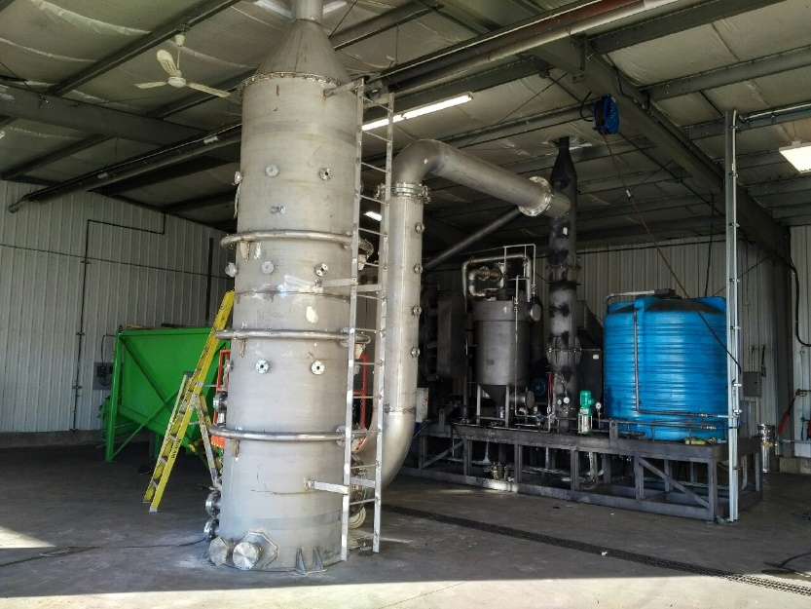
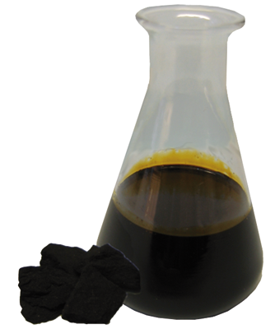
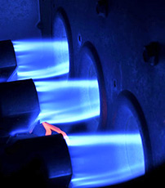
Waste is 100% Recycled
Refuse Derived Fuel (RDF) pellets are supplied to the ATS Plant
Biochar is produced and may optionally be refined to an Activated Carbon
Synthetic Gas is created and used as a fuel source for the Plant
Pyrolysis Oil is extracted and can be further refined to add value

Slide 16
Profit Potential for 5 ATS2000 Plants Processing – MSW, food waste, etc. for a small township
Municipal Solid Waste (MSW) – 5 @ ATS2000
Manufactured Product | % of | Annual | Price Per Tonne | Revenue
 | Output | Output
Light Fuel Oil | 40% | 26,862 | $400 | $10,744,800
Bio Oil | 40% | 5,091 | $200 | $1,018,273
Activated Carbon |  | 31,821 | $2,500 | $79,552,584
Recovered Steel | 2.3% | 4,175 | $300 | $1,252,350
Glass | 3.6% | 6,534 | $100 | $653,400
PET & PVC | 4% | 7,260 | $1,000 | $7,260,000
Tipping Fee |  | 310,250 | $100 | $31,025,000
Total Revenue | 90% |  |  | $131,506,407
Approx. Operational Expenses |  |  |  | $23,473,191
Royalty |  |  |  | $6,575,320
Net Income (before taxes) |  |  |  | $101,457,896
Notes:
Based on 850 Tonnes Per Day for 330 Operating Days Per Year All figures are shown in US Dollars
Additional by-products may be produced that would both generate power and heat for the plant, and potentially produce additional revenue. All ProForma financials are prepared by personnel from Magnum’s manufacturing Associate, MGI Thermolysis Systems Inc, with input from Emergent Waste Solutions Inc., Magnum’s Licensee for Canada.

Slide 17
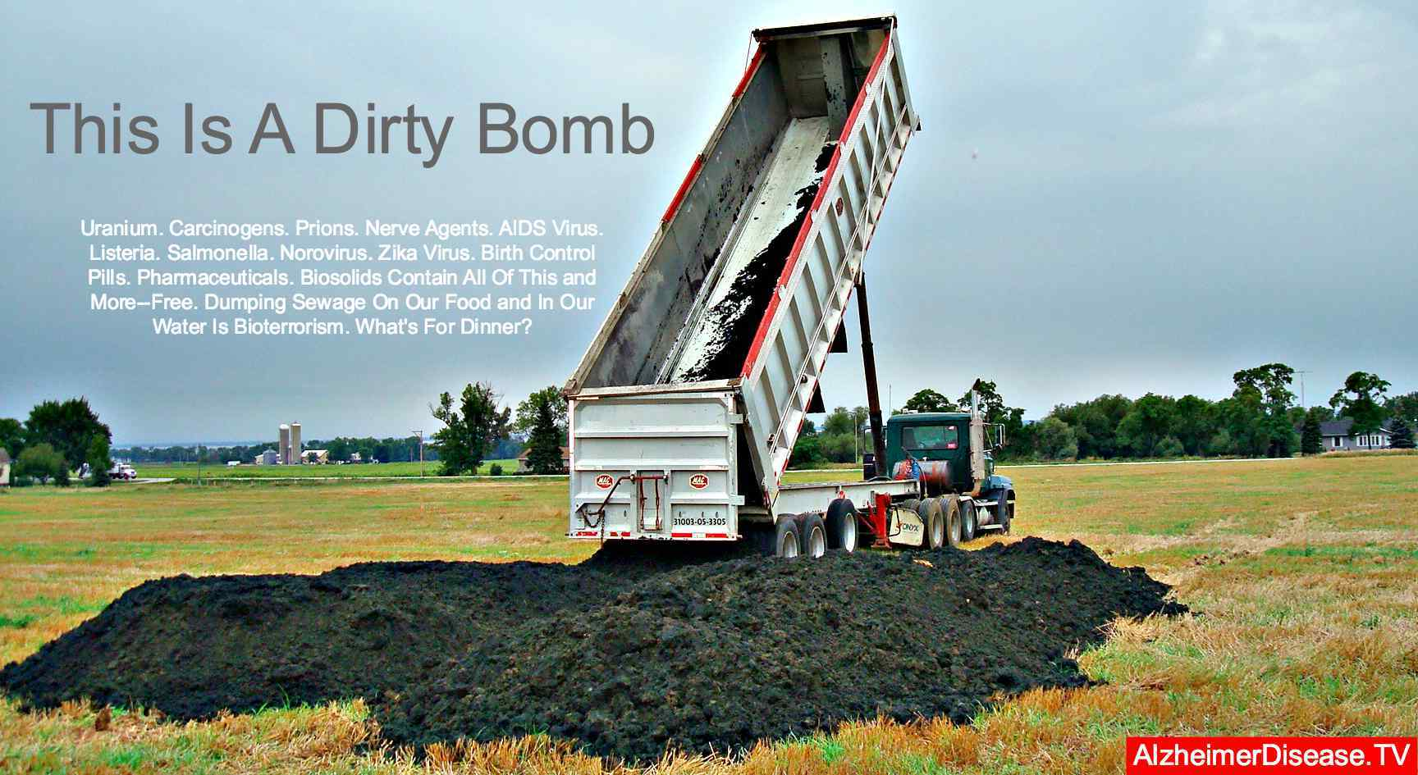
Sewage Biosolids
https://bioscienceresource.org/sewage-sludge-biosolids-land-application-health-risks-and-regulation-2/

Slide 18
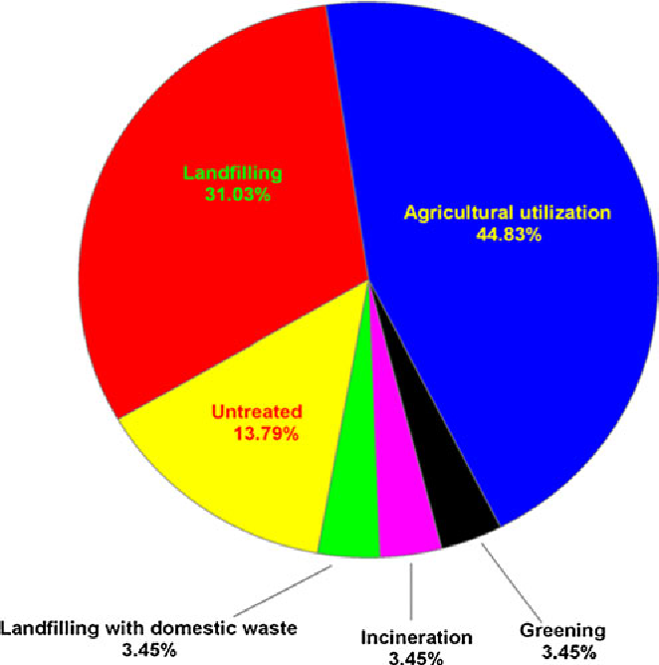
Data from China – Disposing of Biosolids
Sewage sludge (biosolids) refers to the residual, semi-solid material that is produced as a by-product during sewage treatment of industrial or municipal wastewater.
@article{Chen2012UtilizationOU, title={Utilization of urban sewage sludge: Chinese perspectives.}, author={Hong Chen and S-H Yan and Z-L Ye and H-J Meng and Y Zhu}, journal={Environmental science and pollution research international}, year={2012}, volume={19 5}, pages={1454-63} }

Slide 19
The Biosolids Solution
Biochar production by sewage sludge pyrolysis - Chania, Greece - Evita Agrafiotia, George Bourasa, Dimitrios Kalderisb, Evan Diamadopoulosa
Pyrolysis suppressed heavy metal release for the non-impregnated biochars, indicating that there is no environmental risk using sludge-derived biochars as soil amendments.
Nutrients and Heavy Metals in Biochar Produced by Sewage Sludge Pyrolysis: It’s Application in Soil Amendment – Guiyang, China - Taoze Liu, Bangyu Liu, Wei Zhang
Applying sewage sludge biochar to infertile and polluted soils promoted the plant growth and increased the fresh matter weight of Chinese cabbage. Heavy metals were not prone to bioaccumulation in the plant, and the plant availability of heavy metals was reduced in polluted soil.
Application of biochar from sewage sludge to plant cultivation: Influence of pyrolysis temperature and biochar-to-soil ratio on yield and heavy metal accumulation – Shanghai, China - X.D. Song, X.Y. Xue, D.Z. Chen, P.J. He, X.H. Dai
Experimental results revealed that biochars were rich in nutrient contents and they improved garlic yields.
Influence of pyrolysis temperature on production and nutrient properties of wastewater sludge biochar – NSW, Australia - Mustafa K. Hossain, Vladimir Strezov, K. Yin Chan, Artur Ziolkowski, Peter F. Nelson
Our results indicate there is a great potential to convert wastewater sludge to biochar in order to improve the management of this waste, reduce its transport costs and reduce the production volume.
The Changes of Heavy Metals in Sewage Sludge Following Pyrolysis Treatment - China - Ma T; Song Y; Zhao X; Li G; Lin Q
Heavy metals in this research, mainly existed in inertial form in biochar, indicated their availability to plants becoming less after carbonization.
there is no environmental risk using sludge-derived biochars as soil amendments
Heavy metals were not prone to bioaccumulation in the plant
Biochars were rich in nutrient contents and they improved garlic yields
there is a great potential to convert wastewater sludge to biochar
Heavy metals…mainly existed in inertial form in biochar

Slide 20
The Biosolids Solution
Nutrients and Heavy Metals in Biochar Produced by Sewage Sludge Pyrolysis: Its Application in Soil Amendment - China - Taoze Liu, Bangyu Liu, Wei Zhang
The sewage sludge biochar can improve soil fertility and enhance plant growth while not increasing plant uptake of heavy metals, and remedied contaminated soil by reducing the plant availability of heavy metals.
Flash pyrolysis of heavy metal contaminated biomass from phytoremediation: Influence of temperature, entrained flow and wood/leaves blended pyrolysis on the behaviour of heavy metals - Belgium - M. Stalsa, E. Thijssena, J. Vangronsveldb, R. Carleera, S. Schreursc, J. Ypermana
Flash pyrolysis can likely offer a valuable processing method for heavy metal contaminated biomass, thus limiting the waste disposal problem associated with phytoremediation.
Masters student Zoe Williamson carried out the survey under the supervision of Professor Alistair Boxall at the University of York in the UK.
Researchers at the University of York say that more should be done to tackle the problem of inappropriate disposal of pharmaceutically-contaminated wastes. They also have a potential solution…The technology relies on pyrolysis, a thermochemical decomposition process using high temperatures and an absence of oxygen, followed by catalytic conversion to clean and convert the gases. Seventeen of the most thermally stable pharmaceuticals were tested in the trial, which revealed that pyrolysis technology destroys over 99 per cent of 10 of the pharmaceuticals and an average of 94 per cent of the remaining seven.
remediated contaminated soil by reducing the plant availability of heavy metals
…offer a valuable processing method for heavy metal contaminated biomass
17 of the most thermally stable pharmaceuticals were tested in the trial, which revealed that thermolysis technology destroys over 99% of 10 of the pharmaceuticals and an average of 94% of the remaining 7.

Slide 21
Profit Potential for an ATS2000 – processing Biosolids
Sewage Bio-Solids (Canadian Example) - ATS2000
Manufactured Product | % of | Annual | Price Per Tonne | Revenue
 | Output | Output
Biochar | 30% | 4,752 | $1,500 | $7,128,000
Tipping Fees |  | 3,500 | $400 | $1,400,000
Total Revenue |  |  |  | $8,528,000
Cost of Goods Sold |  |  |  | $456,192
Royalty | 5 |  |  | $356,400
Approx. Operational Expenses |  |  |  | $866,075
Net Income (before taxes) |  |  |  | $6,849,333
Notes:
Based on 24 Tonnes Per Day for 330 Operating Days Per Year All figures are shown in Canadian Dollars Chart assumes a Canadian setting
Additional by-products may be produced that would both generate power and heat for the plant, and potentially produce additional revenue. All ProForma financials are prepared by personnel from Magnum’s manufacturing Associate, MGI Thermolysis Systems Inc, with input from Emergent Waste Solutions Inc., Magnum’s Licensee for Canada

Slide 22
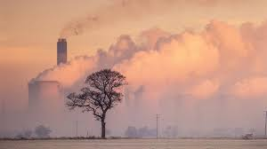
Wood Waste

Slide 23

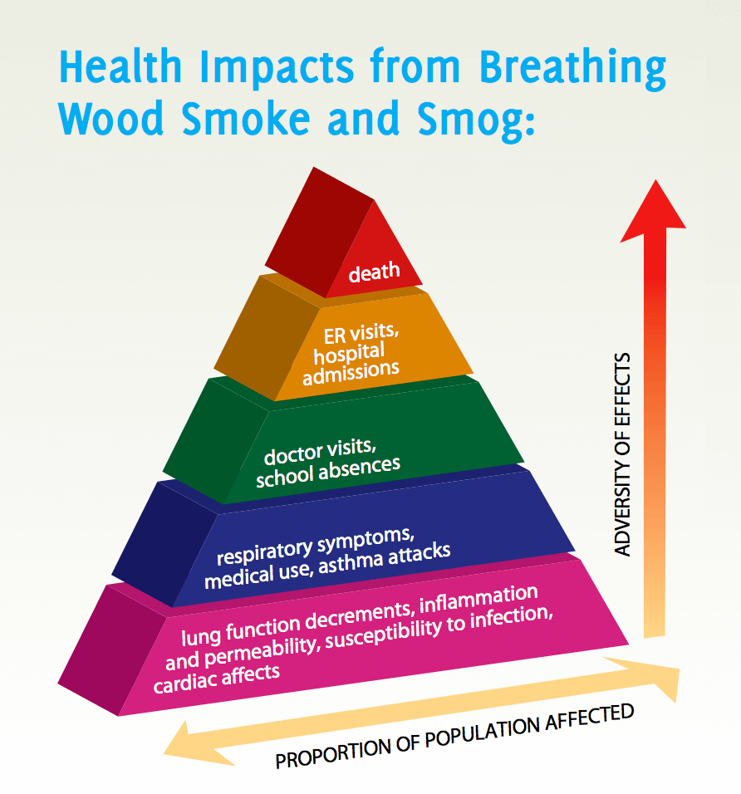
Incineration - Facts
Contaminants in smoke include both fine and coarse particulate matter (PM2.5 and PM10 respectively), carbon monoxide (CO), nitrogen oxides (NOx), and volatile organic compounds (VOC)*
Biomass burning can also release small amounts of toxins such as benzene, acrolein, polycyclic aromatic hydrocarbons (PAHs), formaldehyde, and dioxins and furans*
Main wood smoke contaminants include CO, NOx, and VOCs
Also contains toxins: benzene, acrolein, PAHs, formaldehyde, dioxins & furans
*Open burning includes pile burning of forestry, agricultural, and land-clearing debris and controlled burns for ecosystem restoration, fuel reduction, and ecosystem health.
* From: A Smoke Management Framework for British Columbia, a BC Government Publication
Notes:
From A Smoke Management Framework for British Columbia, a BC Government Publication

Slide 24
Profit Potential for an ATS2000 – processing Wood
Wood - ATS2000
Manufactured Product | % of | Annual | Price Per Tonne | Revenue
 | Output | Output
Biochar | 34% | 9,425 | $2,099 | $19,783,692
Total Revenue |  |  |  | $19,783,692
Cost of Goods Sold |  |  |  | $3,482,846
Approx. Operational Expenses |  |  |  | $999,527
Depreciation |  |  |  | $385,800
Net Income (before taxes) |  |  |  | $14,915,519
Notes:
Based on 24 Tonnes Per Day for 330 Operating Days Per Year All figures are shown in Canadian Dollars Chart assumes a Canadian setting
Additional by-products may be produced that would both generate power and heat for the plant, and potentially produce additional revenue. All ProForma financials are prepared by personnel from Magnum’s manufacturing Associate, MGI Thermolysis Systems Inc, with input from Emergent Waste Solutions Inc., Magnum’s Licensee for Canada

Slide 25
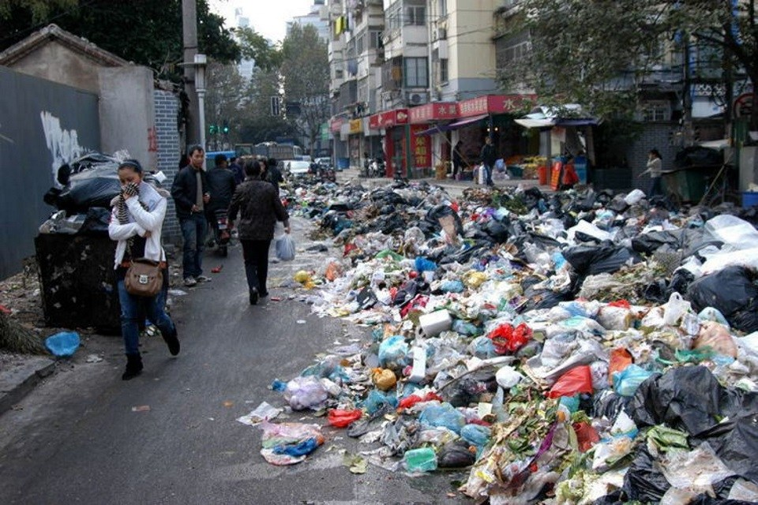
Plastics

Slide 26
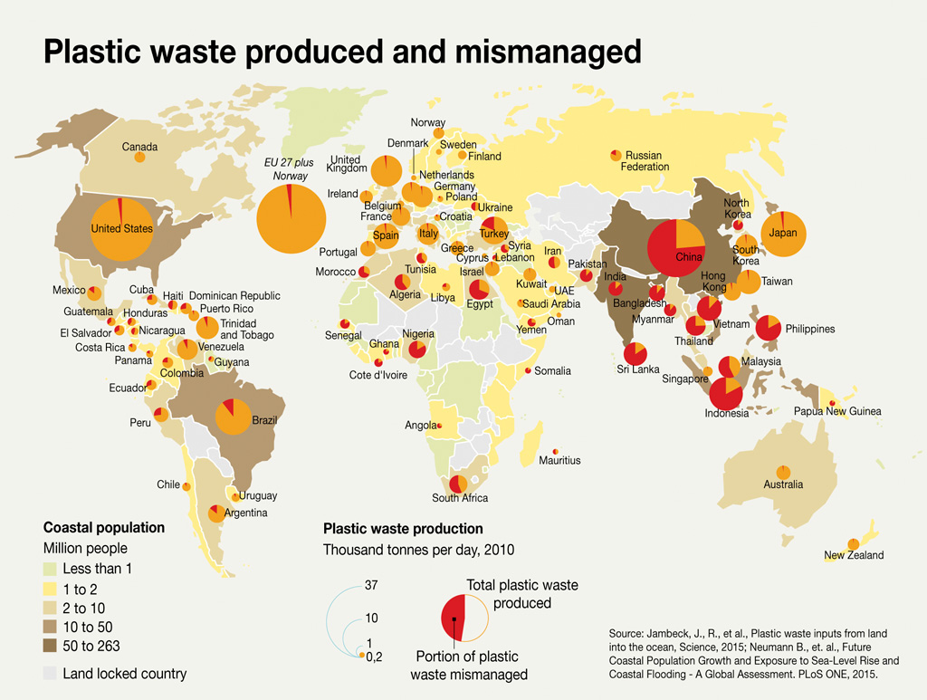
ATS - a Game Changer for Plastics

Slide 27
Profit Potential for ATS2000 - Plastics
Plastics - ATS2000
Manufactured Product | % of | Annual | Price Per Tonne | Revenue
 | Output | Output
Light Fuel Oil | 75% | 17,820 | $500 | $8,910,000
Carbon Black N330 Standard | 2% | 475 | $500 | $237,600
Total Revenue |  |  |  | $9,147,600
Approx. Operational Expenses |  |  |  | $3,381,494
Royalty |  |  |  | $457,380
Net Income (before taxes) |  |  |  | $5,308,726
Notes:
Based on 24 Tonnes Per Day for 330 Operating Days Per Year All figures are shown in US Dollars
Additional by-products may be produced that would both generate power and heat for the plant, and potentially produce additional revenue. All ProForma financials are prepared by personnel from Magnum’s manufacturing Associate, MGI Thermolysis Systems Inc, with input from Emergent Waste Solutions Inc., Magnum’s Licensee for Canada

Slide 28
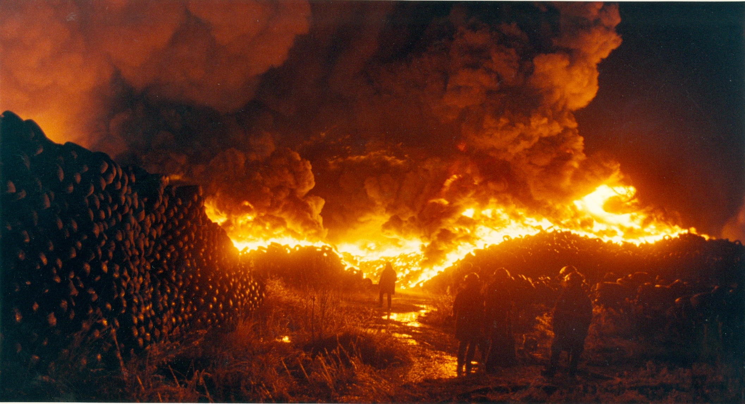
Tires

Slide 29
Tires
Worldwide
It is estimated that approximately 1.2 Billion used tires are disposed of each year, worldwide and 7 Billion used tires sit in existing landfills. Further it is estimated that over 700 Million tires are manufactured every year and as the emerging countries such as India and China see an ever increasing demand for automobiles, the disposal of used tires becomes an ever increasing environmental problem. This is particularly evident in some of the poorest countries of the world where piles of used tires have been dumped and remain a major hazard at risk of igniting and burning for years.
USA
In the US the federal Environmental Protection Agency reports that 290 million used tires are generated each year and an estimated 2 Billion used tires have accumulated in stockpiles or uncontrolled tire dumps across the country. A variety of pests, including mosquitoes capable of carrying West Nile virus, breed and live in water collected in discarded old tires, Tires also take up much-needed landfill space and create a blight on the urban landscape as well as resulting in a large amount of black solid refuse which contaminates the soil and ground water.
Canada
In Canada we discard 33 Million Tires annually. Our issues with used tires parallel those of the USA and as such Canada is under a strong onus to address them.
Used tires represent a primary feedstock for the pyrolysis system. Traditional pyrolysis systems have produced lower quality products which have consequently attracted lower market prices. The AATS system overcomes these difficulties and produces marketable high quality products to satisfy the demands of industry.
http://www.businesswire.com/news/home/20090331006457/en/Timberland-Teams-Green-Rubber%E2%84%A2-Reduce-Global-Tire
http://www.newswire.ca/en/releases/archive/August2010/12/c2170.html
1.2 Billion tires disposed of annually – 7 Billion tires sit in existing landfills
Waste tires are an ideal host environment for insects that carry viruses such as West Nile
Canada under strong onus to address the annual 33 Million discarded tires
ATS creates high value products without polluting

Slide 30
Profit Potential for ATS2000 - Tires
Tires – using an ATS2000 system
Manufactured Product | % of | Annual | Price Per Tonne | Revenue
 | Output | Output
Light Fuel Oil | 40% | 6,336 | $400 | $2,534,400
Carbon Black N330 Standard | 38% | 6,019 | $2,000 | $12,038,400
Recovered Steel | 7% | 1,109 | $300 | $332,640
Tipping Fee |  | 15,840 | $300 | $4,752,000
Total Revenue |  |  |  | $19,657,440
Approx. Operational Expenses |  |  |  | $3,571,690
Royalty |  |  |  | $982,872
Depreciation |  |  |  | $525,000
Net Income (before taxes) |  |  |  | $14,577,878
Notes:
Based on 24 Tonnes Per Day for 330 Operating Days Per Year All figures are shown in Canadian Dollars Chart assumes a Canadian setting
Additional by-products may be produced that would both generate power and heat for the plant, and potentially produce additional revenue. All ProForma financials are prepared by personnel from Magnum’s manufacturing Associate, MGI Thermolysis Systems Inc, with input from Emergent Waste Solutions Inc., Magnum’s Licensee for Canada

Slide 31
ATS – Clearly the World’s Best
The most advanced physical activation system
Eliminates incomplete feedstock penetration
Eliminates tar build-up in the system
Employs a triple reactor system, each with its own motor
Allows heat to be independently controlled in each reactor
Incorporation of super-heated steam
Penetration of feedstock for better breakdown
Removal of volatiles from the reactors to prevent recontamination
Eliminates the problem of organic soot and tar building up in the circulatory systems
Creates a purer carbon that more easily transitions to activated carbon
Created from waste heat from the reactors for greater system efficiency
Venturi Condenser Employed
Increases flash point temperature of the fuel oil from 40º to ~75º
Separates steam from fuel oil and synthesized gas
Keeps the base elements from cross-contaminating
Maintains a high enough temperature to prevent the chemical reaction that creates dioxins and furans during the condensing process in other systems

Slide 32
ATS – Clearly the World’s Best
Additional Points of Superiority of the ATS system
Does not use a vacuum pump to create the oxygen-free environment
Utilizes an auger to move feedstock in the reactors, thereby mixing the feedstock as it moves through the system and allowing more uniform penetration
Employs a method of dispersing explosive synthesized gas in the event of a shutdown due to power failure
A nitrogen fire suppression system is connected to the reactors in order to extinguish any fires in the reactors or thermal chamber
The BTU value of the synthesized gas is increased with a vortex pre-mixing chamber
The system design allows access to the piping system for cleaning and maintenance
Dual flap air lock gates are used instead of dual blade gates, thereby eliminating a problem other systems have with particulate build-up on the sliding blades, which may eventually allow ambient air to enter the reactors
Energy efficiency is superior as the methodologies employed to capture, purify, enhance and ignite the synthesized gas allow the system to operate using virtually all of its own created fuel

Slide 33
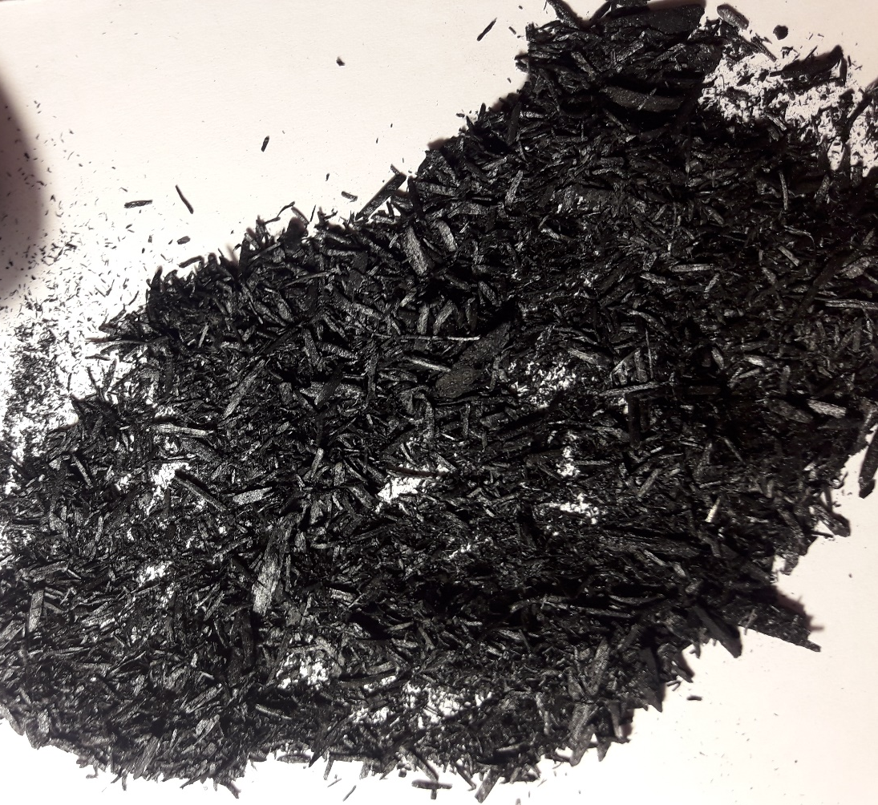
Producing Biochar and/or Activated Carbon
Biochar is a carbon-rich product produced when biomass, such as wood, manure or leaves, food waste, etc. is heated with little or no available oxygen. Sustainable biochar is a powerful simple tool that can: fight climate change, make soil more fertile and drought resistant, reduce agricultural waste, produce clean renewable energy and serve a multitude of other functions.
Our biochar is of such a high quality that we significantly exceed the guidelines created by the European Union to govern the production and characteristics of biochar. Further processing of the biochar through an extra reactor of the advanced ATS system, will produce activated carbon, a high value product.

Slide 34
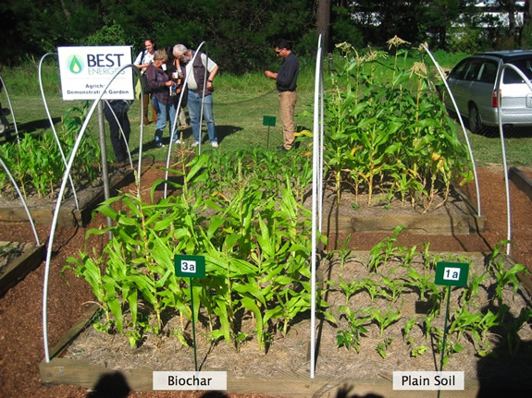
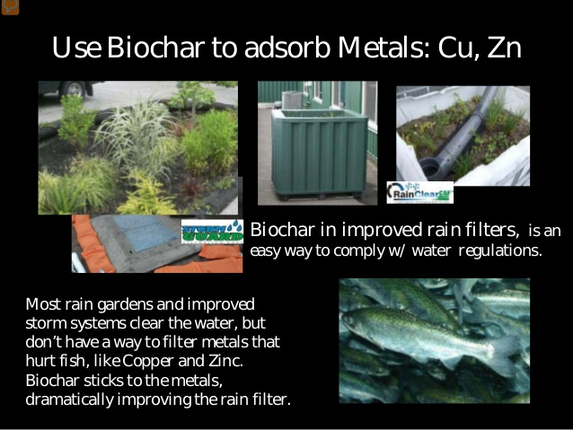
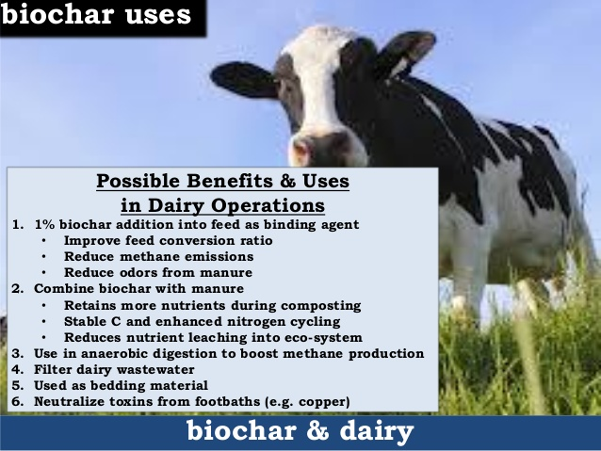
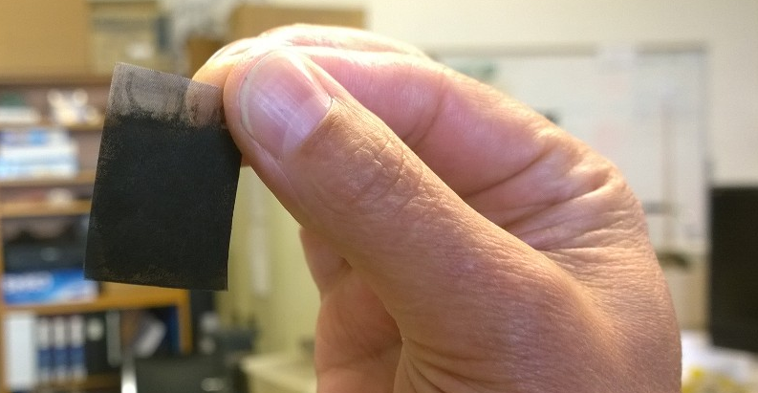
Producing Superior Biochar
Soil Amendment
Filtration
Livestock
High-Tech
(e.g. Electrode)

Slide 35
Producing Superior Biochar
Contrasting Magnum Biochar with European Guidelines
Criteria | Comments
Feedstock | Our biochar is from only organic, sustainably sourced, wood fibre that is free of contaminants.
 | Our feedstock is waste material that would otherwise have been burned, releasing all the greenhouse gasses in that material.
 | It is free from all non-organic material and free of paint, solvents and other organic, or non-organic, contaminants.
 | Our feedstock is 100 km from our biochar plant. In Europe, it may be practical to enforce an 80-km rule, however in Canada, with our sparse population and vast areas, it is not always reasonable.
Manufacturing Specifications | Our thermolysis temperature does not fluctuate more than 20%. In fact, our temperature remains constant to within 1%.
 | The composition of the biomasses does not fluctuate more than 15%.
 | Complete production data, including temperature settings, are kept
Sampling Methodology | We are able to adhere to the sampling guidelines as presented in the source document.

Slide 36
Producing Superior Biochar
Biochar Properties | The guidelines call for a carbon content greater than 50%: our Emergent Biochar is greater than 80% carbon.
 | H/C ratio is mandated to be less than 0.7, whereas Emergent Biochar is less than .04.
 | O/C ratio must be less than 0.4, whereas our Biochar is less than 0.15.
 | A list of Volatile Organic Compounds can be made available. The high temperature steam component of our process captures the VOC’s and drives them into the synthesized gas outlet, where they are filtered from the gas, which is used as a fuel source for reactor heating. Residual VOC are ≤ 0.5%
 | Nitrogen, phosphorus, potassium, magnesium and calcium are not present in our biochar.
 | Emergent Biochar stays below published thresholds for heavy metals as the feedstock contains only what is naturally found in wood fibre.
 | pH value is 8.55, which is in the recommended range stated in the guidelines
 | Ash content is 2.70% ± 0.756%
 | Surface area is ≥ 413 m²/g, significantly above the recommended minimum of 150 m²/g.
 | Water content is for safety reasons and can be dictated by the buyer if this is a concern Normal practice for the Company is for 5% moisture content
 | Emergent biochar is well below the 4 mg/kg DM PAH content for premium grade biochar as specified in the guidelines
 | PCB, dioxins and furans are not present in Emergent Biochar
Production Technology | The heat source for the reactors is the reclaimed and scrubbed synthesized gas produced by the system.
 | The surplus synthesized gas is scrubbed and burned, not released to the atmosphere.
 | We comply with emission thresholds for Canada.
 | Surplus heat from the reactors is used as fuel for the boiler system.
Shipping & Handling | All safety regulations are followed.
 | As noted, moisture is added to the biochar to ensure against dust generation or dust explosions.

Slide 37
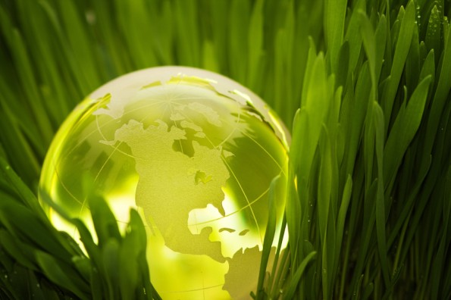
Please send all enquiries to : info@magnumgroup.net
Notes:
37

